Slide 1

Filling vessels
This material is provided by the FunThink team, responsible institution:
Ludwigsburg University of Education
Unless otherwise noted, this work and its contents are licensed under a Creative Commons License (CC BY-SA 4.0). Excluded are funding logos and CC icons / module icons.

Slide 2
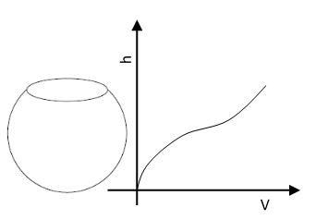
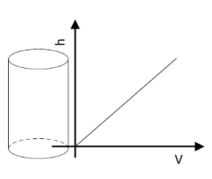
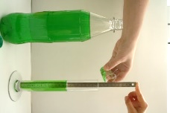
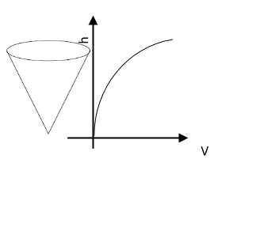
Filling vessels

Slide 3
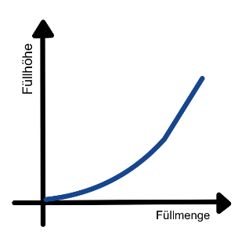
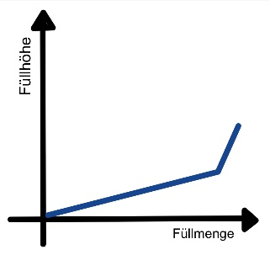
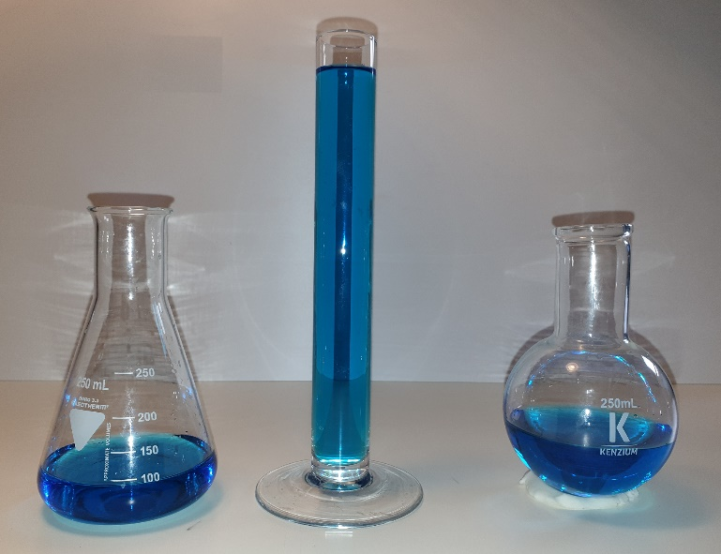
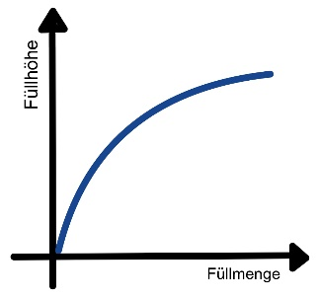
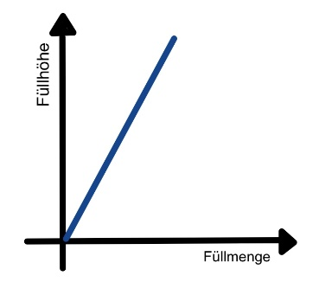
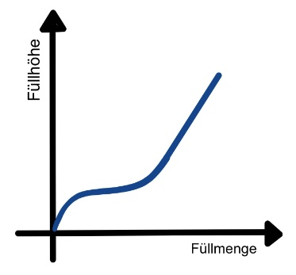
Which graph fits which vessel?
(E)
(A)
(D)
1 2 3
(B)
(C)

Slide 4
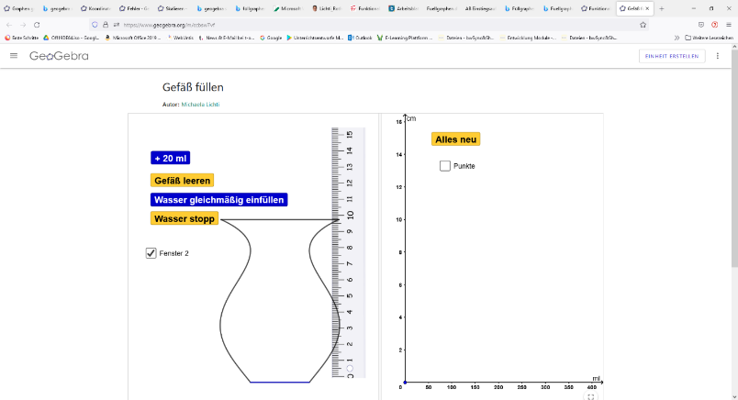

Research assignment
Version A

Slide 5

Research assignment
Version C

Slide 6
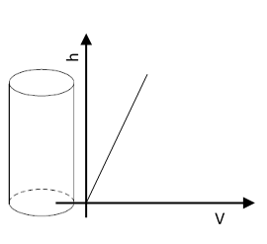
Research finding “Filling vessels”
Vessels and corresponding graphs
Finding:
With increasing width of the vessel,
the vessel fills _______________ and the corresponding graph is ______________.
If the shape of the vessel changes, the graph also changes.
slower
flatter

Slide 7

Research finding “Filling vessels”
Finding:
Vessels and corresponding graphs
The faster the filling height changes, the __________ is the vessel in this area.
The corresponding graph runs ______________.
narrower
steeper

Slide 8
Which graph fits which vessel?
(E)
(A)
(D)
1 2 3
(B)
(C)

Slide 9
A. Water is let into the pool at an even speed. Which of the graphs shown matches this?
filling height
filling height
filling height
time
time
time
Barzel, B., Glade, M. & Klinger, M. (2021). Algebra und Funktionen. Springer Berlin Heidelberg. https://doi.org/10.1007/978-3-662-61393-1

Slide 10
B. Which graph matches the vessel?
①
②
③
④
A
B
C
D
Kempf, H. (2015). Füllgraphenmemory: Eine Spielidee zur Untersuchung funktionaler Zusammenhänge. Mathematik 5-10(30), 28–29.

