Slide 1

Walking Graphs
This material is provided by the FunThink team, responsible institution:
Ludwigsburg University of Education
Unless otherwise noted, this work and its contents are licensed under a Creative Commons License (CC BY-SA 4.0). Excluded are funding logos and CC icons / module icons.

Slide 2
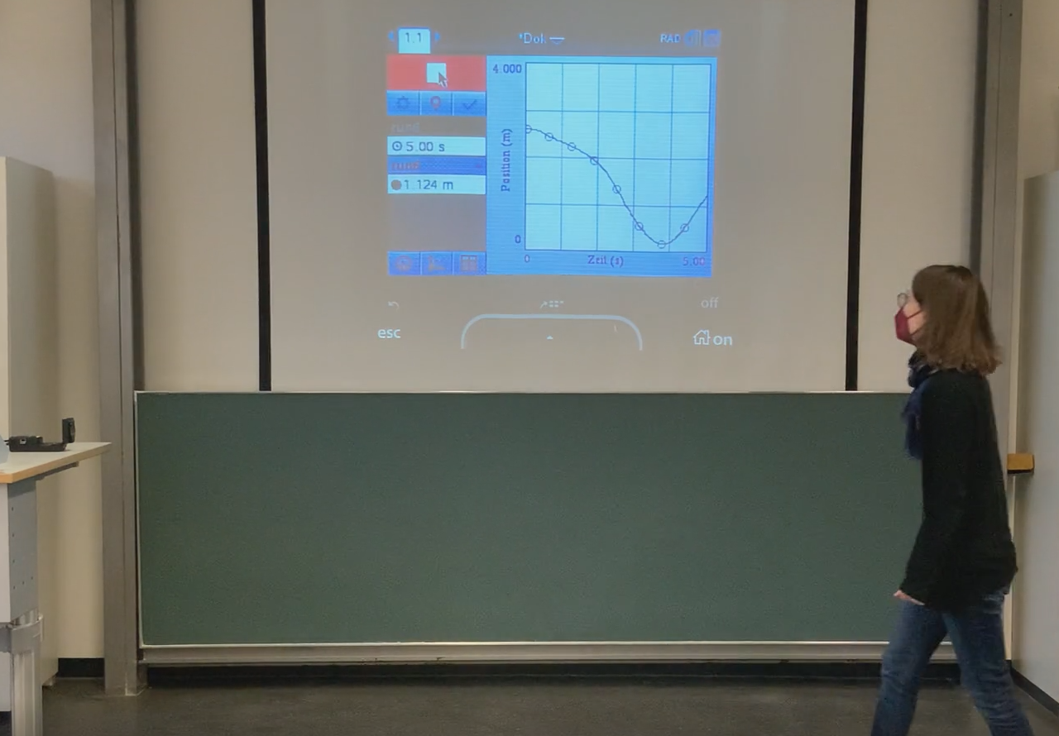
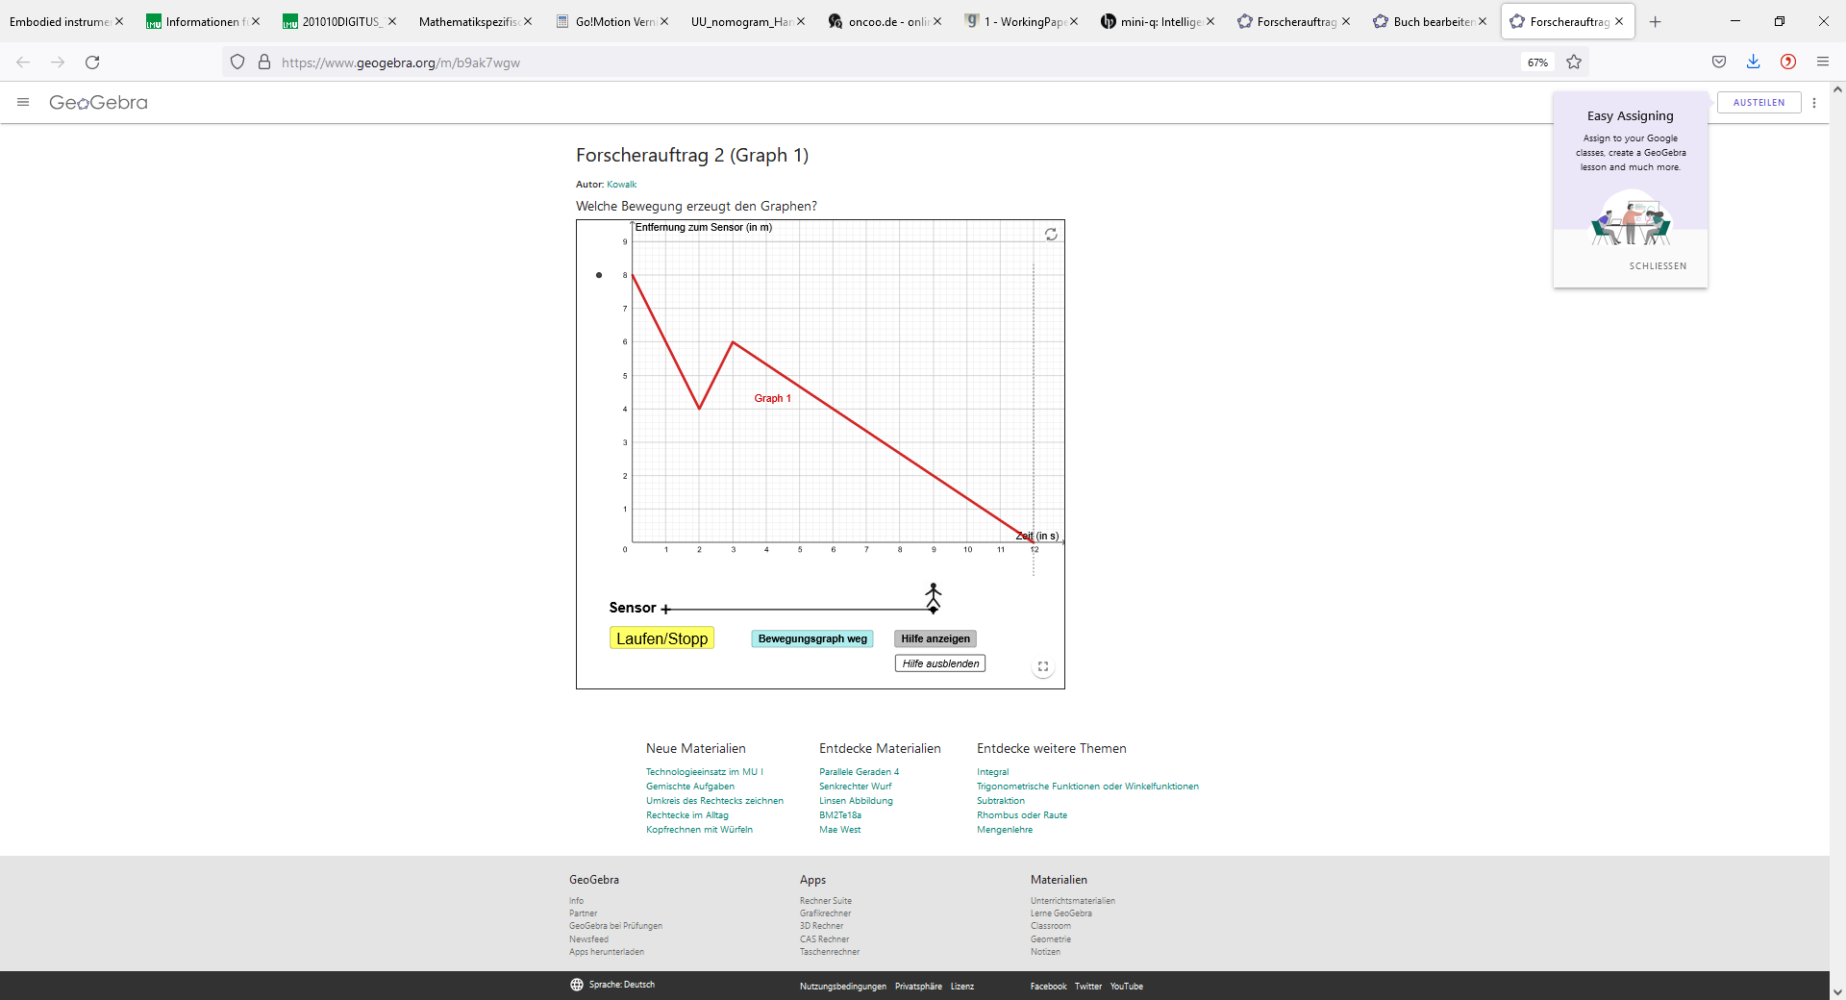
Walking graphs

Slide 3

https://www.geogebra.org/m/rxtznqvc

Slide 4
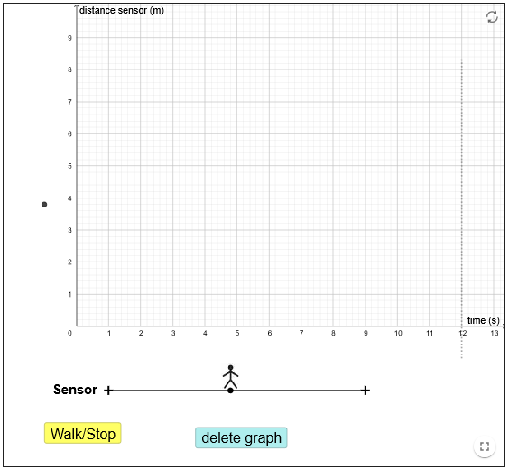
Your position at the beginning
This is you.
Your graph is being recorded starting at time=0
Movement
Notes:
Laufen/Stopp: Aufzeichnung wird gestartet und kann angehalten werden.
Bewegungsgraph weg: Graph wird entfernt

Slide 5
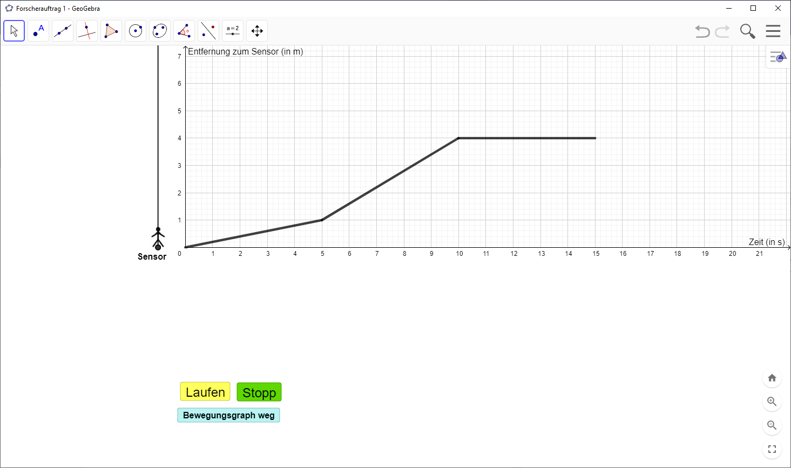
“The language of graphs”
③
②
④
①
I move slowly and evenly away from the sensor.
I move fast and evenly away from the sensor.
I don’t move.
I move first slowly, then faster and faster towards the sensor.
movement
The graph rises/increases steadily, fairly flat.
The graph rises/increases steadily, fairly steep.
The graph runs parallel to the x-axis.
The graph decreases irregularly.
graph

Slide 6
“The language of graphs”
③
②
④
①
slope
positive
positive
0
negative

Slide 7
How do these graphs differ?
Argue with the help of movements and the shape of the graphs.
distance sensor
Distance sensor
time
time
Lz-Item A
Notes:
To reduce the mistake: illusion of linearity
Differences: starting point; even movement vs uneven movement; straight line vs. Non staight line
Optional:
Similarities: What do these graphs have in common? – In both situations, the movement is away from the sensor → graphs increase

Slide 8
Which graph matches the described movement?
I start moving at some distance from the sensor. I first move away from the sensor and slow down. Then, I move first slowly and then faster and faster towards the sensor. At some distance from the sensor, I slow down again and almost stop. I move slowly away from the sensor again and become faster and faster.
Distance sensor
Distance sensor
Distance sensor
Time
time
time
①
②
③
Lz-Item A
Notes:
3

Slide 9
Which graph cannot be walked?
Distance sensor
Distance sensor
Distance sensor
time
time
time
①
②
③
Lz-Item B
Notes:
2

Slide 10
Comment on the following statement:
"With this graph, you move in a zigzag away from the sensor. Just the way the graph looks..."
Distance sensor
time
Lz-Item C

